Slide 1
Exploring Correlation Between College Statistical Categories and NBA Success
UCB Extension: Data Analytics
Ilana Portugal, Erik Rolston, Philip Ring, James Fang, Nassim Ataii

Slide 2
Project Topic & Background
Our topic is focused on college statistical categories and their correlation to NBA career success. This topic was selected to determine if there are stats of NBA players' college career that are indicators of NBA career success, and if they can be used when predicting the success of other college athletes entering the NBA. If a correlation in our analysis is found, it can be a valuable indicator for predicting the success of incoming players drafted for the NBA.

Slide 3
Description of Data
Number of all-star appearances
Length in the league
Career length
Win shares per 48 min play
Number of years played in college
Massive injuries that will serve as outliers
The sources for our data are the following:
To compare player career statistics between the NBA and NCAA to give an overall view of a player's career trajectory: https://data.world/bgp12/nbancaacomparisons
Measurements for NBA draft combine participants from DraftExpress.com: https://data.world/achou/nba-draft-combine-measurements
NBA Player Data Per Season From 1978-2016: https://data.world/jgrosz99/nba-player-data-1978-2016

Slide 4
Questions To Be Answered
We aim to answer the following questions:
Is there any correlation between a player's college career and their NBA success?
Is there any biometric data to support a correlation between player stats and NBA success?
Can these correlations be used as an efficient predictive model for future players being drafted to the NBA?

Slide 5
Description of Data Exploration Completed
A machine learning model was created by the following:
Determine the number of unique values in each column for potential binning
Split preprocessed data into our features and target arrays
Define the model and layers
Compile, train, and Evaluate the model using the test data
Notes:
Include details on SQL cleanup prior to applying machine model

Slide 6
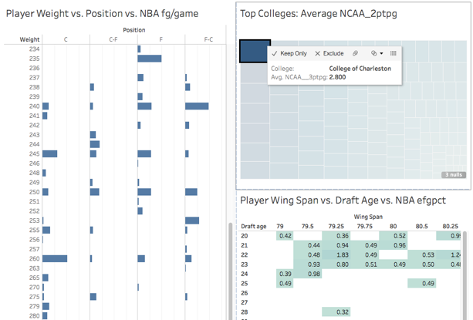
Description of Analysis
EXAMPLE SCREENSHOT (Not Final)
**Insert Data Visualization **
List Tableau functions used
Description of trends shown by tableau dashboard
1. Observation:
2. Observation:
3. Observation:
Conclusion:
Link to Tableau Story

Slide 7
Technologies, Tools, Language, Algorithms
The following were used to complete the exploration and analysis of our data:
Tableau - data visualization.
SQL - clean, organize, store data.
Machine Learning - create model using sklearn, pandas to import data, establish model, and evaluate its accuracy.

